Slide 1
Database Management Systems

Slide 2
Module 2.1: Relational Model

Slide 3
Agenda
Relational Model Concepts
Relational Model Constraints and Relational Database Schemas
Update Operations and Dealing with Constraint Violations

Slide 4
Relational Model Concepts
The relational Model of Data is based on the concept of a Relation
A Relation is a mathematical concept based on the ideas of sets
The model was first proposed by Dr. E.F. Codd of IBM Research in 1970
Notes:
Do a quick review of the theoretical concepts(already available in recorded lectures) and focus on exercises.

Slide 5
Relational Model Characteristics
Using this representational (or implementation) model we represent a database as collection of relations.
The notion of relation here is different from the notion of relationship used in ER modeling.
Relation is the main construct for representing data in relational model.
Every relation consists of a relation schema and Relation instance.
Notes:
Representational model –discussed in session 1

Slide 6
Relational Model Characteristics
Relation Schema is denoted by
The number of columns in a relation is known as its degree or arity’.
A relation of degree seven, which stores information about university students, would contain seven attributes describing each student.
STUDENT(Name, Ssn, Home_phone, Address, Office_phone, Age, Gpa)
Using the data type of each attribute, the definition is sometimes written as:
STUDENT(Name: string, Ssn: string, Home_phone: string, Address: string,Office_phone: string, Age: integer, Gpa: real)

Slide 7
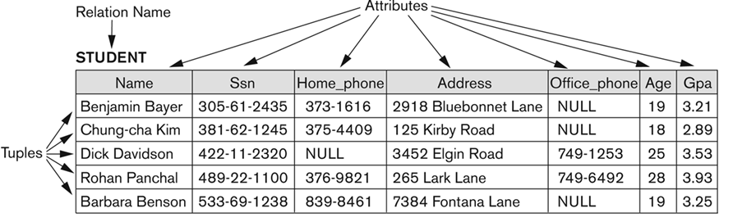
Relational Model Characteristics
Notes:
Explain the previous slide terms using this example.

Slide 8
Relation instance
Relation instance or Relation State (r) of R (thought of as a table)
Each row in the table represents a collection of related data.
Each row contains facts about some entity of same entity-set.
R = (A₁, A₂, A₃,……., A_{n})
r(R) is a set of n tuples in R
r = {t₁, t₂, t₃,…….,t_{n}}
r is an instance of R each t is a tuple and is a ordered list of values.
t = (v_{1 ,} v_{2 ,…,} v_{n} ) where v_{i} is an element of domain of A_{i}
Attribute A of relation R is accessed by notation- R.A.
Ex: Student (name, age, branch). Here Student is the relation name.
Student.age - denotes age attribute of Student relation.

Slide 9
Relational Model Characteristics
Entities of each type/set are stored as rows in a single relation.
Hence in general, a relation corresponds to a single entity type in ER diagram.
In some cases a relationship between two entities can have some specific attributes which can be captured in a relation (table).
A row is called a tuple.
The columns of the table represent attributes of that entity type.
The column header is known as attribute or field.
Data type or format of an attribute: is the format of data for that attribute. Ex. Character strings, numeric, alphanumeric etc.
Values that can appear in a column for any row is called the domain of that attribute.
Example: “USA_phone_numbers” are the set of 10 digit phone numbers valid in the U.S.

Slide 10
Relational Model Characteristics
Relational Database Schema is denoted by

Slide 11
Characteristics of a Relation
Ordering of tuples is not significant.
Ordering of values in a tuple is important.
Values in a tuple under each column must be atomic (simple & single).
NULL values : used to represent the values of attributes that may be unknown or may not apply to a tuple
Interpretation (Meaning) of a Relation : a type of assertion

Slide 12
Relational Model Characteristics
Key of a Relation:
Each row has a value of a data item (or set of items) that uniquely identifies that row in the table
Called the key
In the STUDENT table, SSN is the key

Slide 13
Terminology
Informal Terms | Formal Terms
Table | Relation
Column Header | Attribute
All possible Column Values | Domain
Row | Tuple
Table Definition | Schema of a Relation
Populated Table | State of the Relation

Slide 14
Relational Constraints
Constraints are restrictions on data of a relation.
Domain level Constrains – Format of data Ex. Character, numeric etc.
Entity integrity constraints – Primary key, unique key
Referential integrity constraints– Foreign key
Semantic Constraints.

Slide 15
Relational Integrity Constraints
Constraints are conditions that must hold on all valid relation states.
There are three main types of constraints in the relational model:
Key constraints
Entity integrity constraints
Referential integrity constraints
Another implicit constraint is the domain constraint
Every value in a tuple must be from the domain of its attribute (or it could be null, if allowed for that attribute)

Slide 16
Key Constraints
Superkey of R:
Is a set of attributes SK of R with the following condition:
No two tuples in any valid relation state r(R) will have the same value for SK
That is, for any distinct tuples t1 and t2 in r(R), t1[SK] ≠ t2[SK]
A superkey can have redundant attributes
Key of R:
“Uniqueness” property
A "minimal" superkey. That is, a key is a superkey K such that removal of any attribute from K results in a set of attributes that is not a superkey (does not possess the superkey uniqueness property)
A key is a superkey, but not vice versa.

Slide 17
Key Constraints (continued) - Example
{Ssn} is a key
{Ssn, Name, Age} is a superkey (but not a key – Why?)

Slide 18

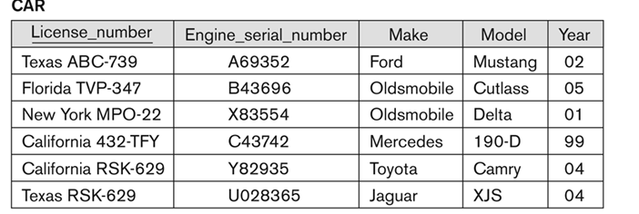
Key Constraints (continued) – Candidate Key
A relation can have many keys – Candidate keys
If a relation has several candidate keys, one is chosen arbitrarily to be the primary key.
Example: Consider the CAR relation schema:
CAR(License_number, Engine_serial_numer, Make, Model, Year)
CKs = {License_number} and {Engine_serial_number}
We chose {SerialNo} as the primary key
The primary key value is used to uniquely identify each tuple in a relation
Provides the tuple identity
Also used to reference the tuple from another tuple
General rule: Choose as primary key the smallest of the candidate keys (in terms of size). Not always applicable – choice is sometimes subjective

Slide 19
Exercise-1
Consider the relation
CLASS (Course#, Univ_Section#, Instructor_name, Semester, Building_code, Room#, Time_period, Weekdays, Credit_hours)
This represents classes taught in a university, with unique Univ_section#s.
Identify what you think should be various candidate keys with justification?
Notes:
Open this question for discussion.
1.If same room cannot be used at the same time by more than one course during a particular semester->{Sem,bulidingcode,Room#,Time,Weekdays}
2.Univ_section#
3.
4.If univ_sec# is not unique…then?discuss.
5.If all sections have unique numbers during a particular sem only…then? discuss

Slide 20
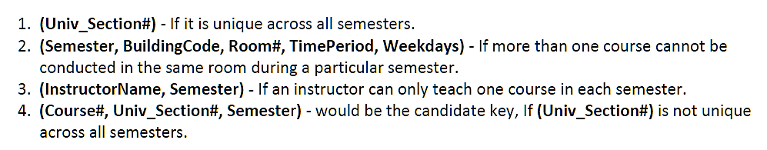
Solution
CLASS (Course#, Univ_Section#, Instructor_name, Semester, Building_code, Room#, Time_period, Weekdays, Credit_hours)

Slide 21
Entity Integrity
Entity Integrity
The primary key attributes PK of each relation schema R in S cannot have null values in any tuple of r(R).
This is because primary key values are used to identify the individual tuples.
t[PK] ≠ null for any tuple t in r(R)
If PK has several attributes, null is not allowed in any of these attributes
Note: Other attributes of R may be constrained to disallow null values, even though they are not members of the primary key.

Slide 22
Referential Integrity
A constraint involving two relations
Used to specify a relationship among tuples in two relations:
The referencing relation and the referenced relation.

Slide 23
Referential Integrity
Tuples in the referencing relation R1 have attributes FK (called foreign key attributes) that reference the primary key attributes PK of the referenced relation R2.
A tuple t1 in R1 is said to reference a tuple t2 in R2 if t1[FK] = t2[PK].
A referential integrity constraint can be displayed in a relational database schema as a directed arc from R1.FK to R2.

Slide 24
Referential Integrity (or foreign key) Constraint
Statement of the constraint
The value in the foreign key column (or columns) FK of the the referencing relation R1 can be either:
(1) a value of an existing primary key value of a corresponding primary key PK in the referenced relation R2, or
(2) a null.
In case (2), the FK in R1 should not be a part of its own primary key.

Slide 25
Other Types of Constraints
Semantic Integrity Constraints:
based on application semantics and cannot be expressed by the model
Example 1: “the max. no. of hours per employee for all projects he or she works on is 56 hrs. per week”
Example 2: “A normal employee can’t draw salary more than the manager”

Slide 26
Displaying a relational database schema and its constraints
Each relation schema can be displayed as a row of attribute names
The name of the relation is written above the attribute names
The primary key attribute (or attributes) will be underlined
A foreign key (referential integrity) constraints is displayed as a directed arc (arrow) from the foreign key attributes to the referenced table
Can also point the primary key of the referenced relation for clarity

Slide 27
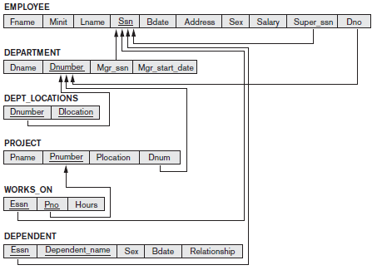
COMPANY DB-Relational Model
Notes:
This model is discussed under the assumption that students are well aware of Company database either from recorded lectures or from Contact session 2.
Use this as an example to explain the constraints discussed before.

Slide 28
Exercise-2: Relational Model
Consider the following relations for a database that keeps track of business trips of salespersons in a sales office:
SALESPERSON (Ssn, Name, Start_year, Dept_no)
TRIP (Ssn, From_city, To_city, Departure_date, Return_date, Trip_id)
EXPENSE (Trip_id, Account#, Amount)
A trip can be charged to one or more accounts. Specify the primary keys and foreign keys for this schema, stating any assumptions you make. Draw the Relational model.
Notes:
Ssn,Trip_id

Slide 29
Exercise-3: Relational Model
Consider the following relations for a database that keeps track of student enrollment in courses and the books adopted for each course:
STUDENT(SSN, Name, Major, Bdate)
COURSE(Course#, Cname, Dept)
ENROLL(SSN, Course#, Quarter, Grade)
BOOK_ADOPTION(Course#, Quarter, Book_ISBN)
TEXT(Book_ISBN, Book_Title, Publisher, Author)
Draw a relational schema diagram specifying the foreign keys for this schema.
Notes:
Ssn,Trip_id

Slide 30
Update Operations on Relations
INSERT a tuple
DELETE a tuple
MODIFY a tuple
Integrity constraints should not be violated by the update operations
Several update operations may have to be grouped together
Updates may propagate to cause other updates automatically. This may be necessary to maintain integrity constraints

Slide 31
Update Operations on Relations
In case of integrity violation, several actions can be taken:
Cancel the operation that causes the violation (RESTRICT or REJECT option)
Perform the operation but inform the user of the violation
Trigger additional updates so the violation is corrected (CASCADE option, SET NULL option)
Execute a user-specified error-correction routine

Slide 32
Operations on Relations and constraints
Actions need to be taken when FK is set , on operations like update, insert, and delete.
If insert a tuple in R1 where the value for c is not in p of R2, then don’t allow.
What if a tuple in R2 is deleted:
Cascade, don’t allow, set to default, set to null.
What if update on R2’s p happens:
Cascade, don’t allow, set to default, set to null.

Slide 33
Operations on Relations and constraints
Operation on relations | Constraints need to be taken care
Insert | Null, Not Null, PK, unique, FK, format, Domain
Delete | FK
Update | Null, Not Null, PK, unique, FK, domain, and Semantic

Slide 34
Operations on Relations and constraints
Employee
Department
SSN | ENAME | AGE | DNo
101 | Kiran | 28 | 10
105 | Gopu | 32 | 20
121 | Ahmed | 29 | 20
136 | John | 28 | 20
138 | Mike | 30 | 30
143 | Ali | 38 | 10
DNo | DNAME | DLOC
10 | Payroll | Che
20 | Prod | Hyd
30 | Acct | Bgl
Op : Care for constraints.
Insert :PK, Unique, null, not null, format, FK
Update :PK, Unique, null, not null, format, FK
Delete :No care
Op : Care for constraints.
Insert : PK, Unique, null, not null, format
Update : PK, Unique, null, not null, format, FK
Delete : FK

Slide 35
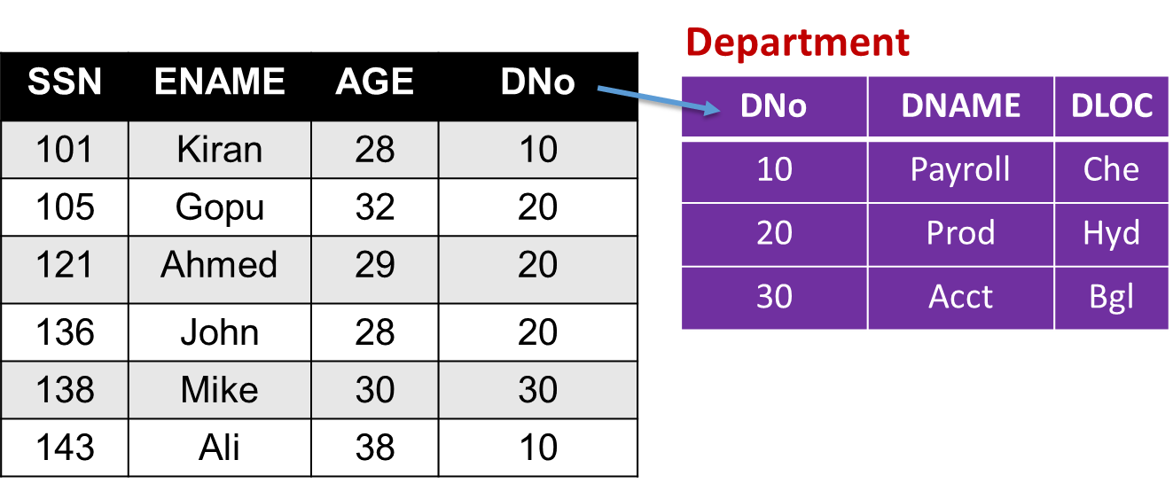
Possible violations for each operation
INSERT may violate any of the constraints:
Domain constraint:
if one of the attribute values provided for the new tuple is not of the specified attribute domain
Key constraint:
if the value of a key attribute in the new tuple already exists in another tuple in the relation
Referential integrity:
if a foreign key value in the new tuple references a primary key value that does not exist in the referenced relation
Entity integrity:
if the primary key value is null in the new tuple

Slide 36
Possible violations for each operation
DELETE may violate only referential integrity:
If the primary key value of the tuple being deleted is referenced from other tuples in the database
Can be remedied by several actions: RESTRICT, CASCADE, SET NULL
RESTRICT option: reject the deletion
CASCADE option: propagate the new primary key value into the foreign keys of the referencing tuples
SET NULL option: set the foreign keys of the referencing tuples to NULL
One of the above options must be specified during database design for each foreign key constraint

Slide 37
Possible violations for each operation
UPDATE may violate domain constraint and NOT NULL constraint on an attribute being modified
Any of the other constraints may also be violated, depending on the attribute being updated:
Updating the primary key (PK):
Similar to a DELETE followed by an INSERT
Need to specify similar options to DELETE
Updating a foreign key (FK):
May violate referential integrity
Updating an ordinary attribute (neither PK nor FK):
Can only violate domain constraints

Slide 38
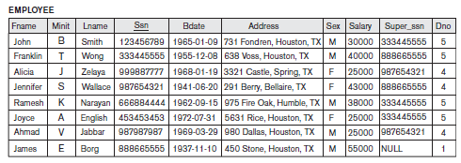
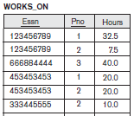
Exercise-4
Suppose that each of the following Update operations is applied directly to the database state shown below. Discuss all integrity constraints violated by each operation, if any, and the different ways of enforcing these constraints.
Insert <‘Robert’, ‘F’, ‘Scott’, ‘943775543’, ‘1972-06-21’, ‘2365 Newcastle Rd, Bellaire, TX’, M, 58000, ‘888665555’, 1> into EMPLOYEE.
Delete the EMPLOYEE tuple with Ssn = ‘123456789’.
Notes:
1.No constraint violation
2.Violates referential integrity

Slide 39
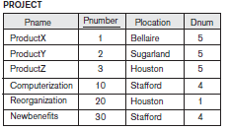

Exercise-5
Suppose that each of the following Update operations is applied directly to the database state shown below. Discuss all integrity constraints violated by each operation, if any, and the different ways of enforcing these constraints.
Insert <‘ProductA’, 4, ‘Bellaire’, 2> into PROJECT.
Insert <‘Production’, 4, ‘943775543’, ‘2007-10-01’> into DEPARTMENT.
Notes:
1.Violates referential integrity
2.Violates key constraint and referential integrity.
Discuss the actions needed to be taken as well. (example 1.reject the insertion or change the value of Dnumer to a new one which does not violate the R.I)

Slide 40
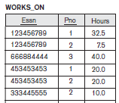
Exercise-6
Suppose that each of the following Update operations is applied directly to the database state shown below. Discuss all integrity constraints violated by each operation, if any, and the different ways of enforcing these constraints.
Insert <‘677678989’, NULL, ‘40.0’> into WORKS_ON.
Notes:
Violates entity integrity and referential integrity

Slide 41
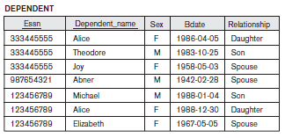
Exercise-7
Suppose that each of the following Update operations is applied directly to the database state shown below. Discuss all integrity constraints violated by each operation, if any, and the different ways of enforcing these constraints.
Insert <‘453453453’, ‘John’, ‘M’, ‘1990-12-12’, ‘spouse’> into DEPENDENT.
Delete the WORKS_ON tuples with Essn = ‘333445555’.
Notes:
1.No violations.
2.No violations.

Slide 42
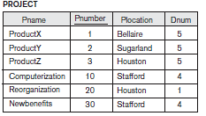

Exercise-8
Suppose that each of the following Update operations is applied directly to the database state shown below. Discuss all integrity constraints violated by each operation, if any, and the different ways of enforcing these constraints.
Delete the PROJECT tuple with Pname = ‘ProductX’.
Modify the Mgr_ssn and Mgr_start_date of the DEPARTMENT tuple with Dnumber = 5 to ‘123456789’ and ‘2007-10-01’, respectively.
Notes:
1.Violates referential integrity.
2.No violations.

Slide 43
Exercise-9
Suppose that each of the following Update operations is applied directly to the database state shown below. Discuss all integrity constraints violated by each operation, if any, and the different ways of enforcing these constraints.
Modify the Super_ssn attribute of the EMPLOYEE tuple with Ssn =‘999887777’ to ‘943775543’.
Modify the Hours attribute of the WORKS_ON tuple with Essn =‘999887777’ and Pno = 10 to ‘5.0’.
Notes:
1.Violates referential integrity.
2.No violations.

Slide 44
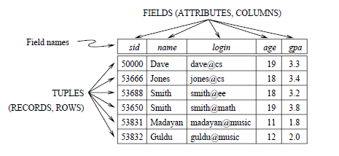
Exercise-10
Give an example of an attribute (or set of attributes) that you can deduce is not a candidate key, based on this instance being legal.
Is there any example of an attribute (or set of attributes) that you can deduce is a candidate key, based on this instance being legal?
Notes:
1.Violates referential integrity.
2.No violations.

Slide 45
Summary
Presented Relational Model Concepts
Definitions
Characteristics of relations
Discussed Relational Model Constraints and Relational Database Schemas
Domain constraints’
Key constraints
Entity integrity
Referential integrity
Described the Relational Update Operations and Dealing with Constraint Violations

